Slide 1
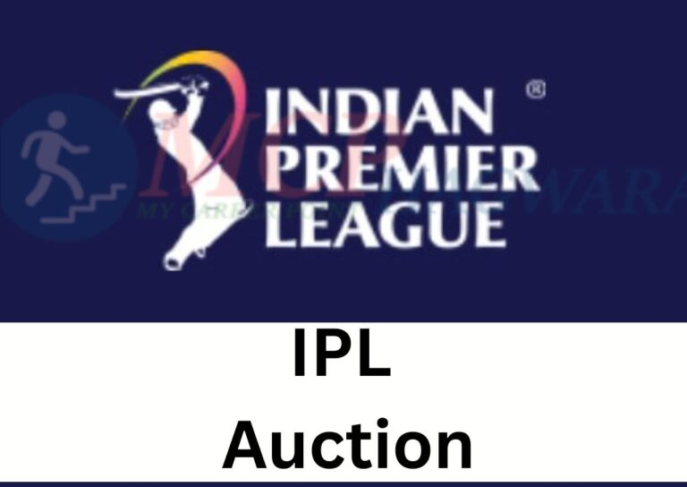
In the same folder I attached a text file where all queries present , this pptx is for presentations
Name: Prerna Rai
Course: Data Science
Project: IPL Auction

Slide 2


Agenda:
1. Brief overview of the project
2. Importance of the IPL auction strategy
3. Data Preparation
4. SQL queries
5. Additional Questions Queries
6.Wicketkeeper Criteria
7.List of all the players for auction

Slide 3

Brief overview of the project
It appears that you have a well-thought-out plan in place for getting ready for the IPL auction by studying historical data and formulating plans to assemble a potent and well-rounded team. The many player types that are required have been delineated by you, including big-hitters, finishers, aggressive batsmen, anchor batsmen, economical bowlers, wicket-taking bowlers, all-rounders, and wicketkeepers. Furthermore, you have given the team management thorough instructions on how to choose players, evaluate the data, and produce visual aids to be presented before to the auction. A wide range of IPL data analysis-related subjects are covered in the supplementary questions for the final evaluation. Examples of these topics include classifying deliveries, counting the cities that have hosted matches, and retrieving certain information from the database.

Slide 4

Importance of the IPL auction strategy
Among the main justifications for the significance of the IPL auction strategy are: Putting together a well-rounded team requires a fair balance between seasoned players and up-and-coming talent. Teams can find players who compliment one other's talents and fit certain roles by using a strong auction strategy.
Budget optimization: Every club has a certain amount of money to spend at the auction, and it's critical to manage this money wisely in order to sign the top players for the group. Teams may make well-informed selections about which players to pursue and at what price with the aid of a clever auction strategy.
Finding important players: Teams can find and sign important players who have the potential to have a big impact on their performance during the auction. Teams can target players who could be game-changers in the event with the aid of a solid auction plan.

Slide 5


Data Preparation
Tools and technologies used:
Relational databases are managed and altered using a programming language called SQL, or Structured Query Language. In addition to enabling users to add, update, delete, and retrieve data, it also lets them see and alter data that is stored in a database. Working with big and complicated datasets requires the usage of SQL, which is extensively utilized in the database administration industry. Because SQL is a declarative language, users define the data they wish to access or alter rather than defining the method. This makes SQL, especially for those with no programming knowledge, quite simple to learn and use. Data description language (DDL), data manipulation language (DML), and data control language (DCL) are the fundamental building blocks of SQL. DDL is used to specify the database's structure, including the creation of tables, constraints, and indexes. DML is used to add, update, and remove entries among other manipulations of data kept in databases. Permissions on tables and other objects can be granted or revoked using DCL, which is used to manage database access.

Slide 6
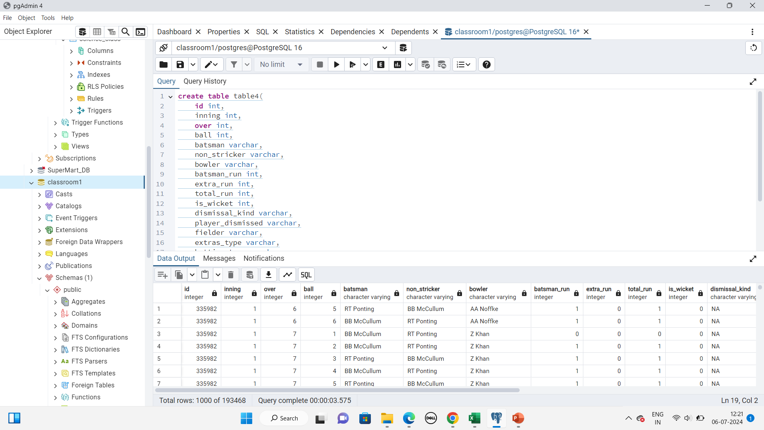
Sql queries:[table4 represent IPL_Ball Data]
Step-by-Step Approach:
First, you need to set up your SQL Server and create the necessary tables to store IPL data. Based on the project requirements.
IPL_Ball.csv
create table table4( id int, inning int, over int, ball int, batsman varchar, non_stricker varchar, bowler varchar, batsman_run int, extra_run int, total_run int, is_wicket int, dismissal_kind varchar,player_dismissed varchar, fielder varchar, extras_type varchar, batting_team varchar, bowling_team varchar);
copy table4 from 'C:\Program Files\PostgreSQL\16\IPL_Ball.csv' delimiter ',' csv header;
select*from table4;
In the same folder I attached a text file where all queries present , this pptx is for presentations

Slide 7
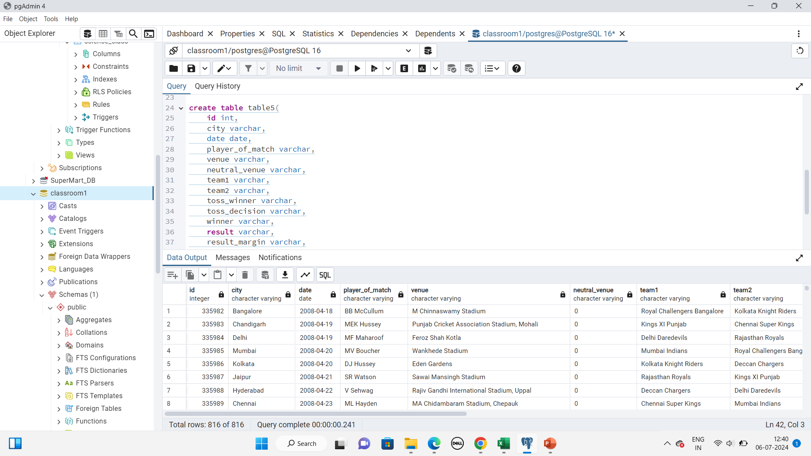
IPL_matches.csv [table5 represent ipl_matches
data
create table table5( id int, city varchar,date date, player_of_match varchar, venue varchar,
neutral_venue varchar,team1 varchar,team2 varchar,toss_winner varchar,toss_decision varchar,
winner varchar,result varchar,result_margin varchar, eliminator varchar, method varchar, umpire1 varchar, umpire2 varchar);
copy table5 from 'C:\Program Files\PostgreSQL\16\IPL_matches.csv' delimiter ',' csv header;
select*from table5;
In the same folder I attached a text file where all queries present , this pptx is for presentations

Slide 8
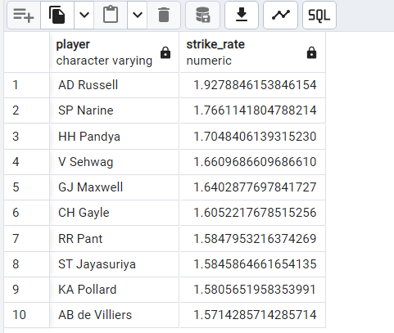
Bidding on Batsman:​
[table4 represent IPL_Ball Data]
Aggressive Batters (High Strike Rate):
SELECT batsman as player, (SUM(total_run) * 1.0 / COALESCE(COUNT(CASE WHEN extras_type != 'wides' THEN table4.ball ELSE NULL END), 1)) AS strike_rate FROM table4 GROUP BY batsman HAVING COUNT(CASE WHEN extras_type != 'wides' THEN table4.ball ELSE NULL END) >= 500 ORDER BY strike_rate DESC LIMIT 10;

Slide 9
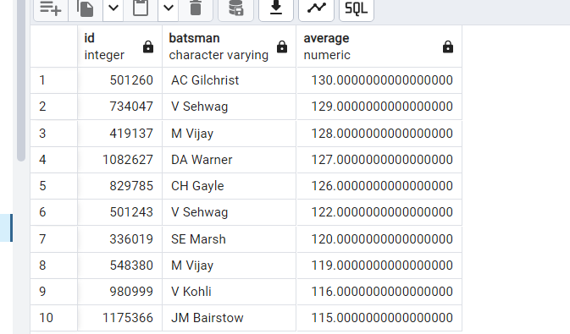
Anchor Batters (Good Average):
SELECT id, batsman, (SUM(total_run) * 1.0 / COUNT(CASE WHEN is_wicket = 1 THEN 1 ELSE NULL END)) AS average FROM table4
GROUP BY id, batsman
HAVING COUNT(CASE WHEN is_wicket= 1 THEN 1 ELSE NULL END) > 0 ORDER BY average DESC
limit 10;

Slide 10
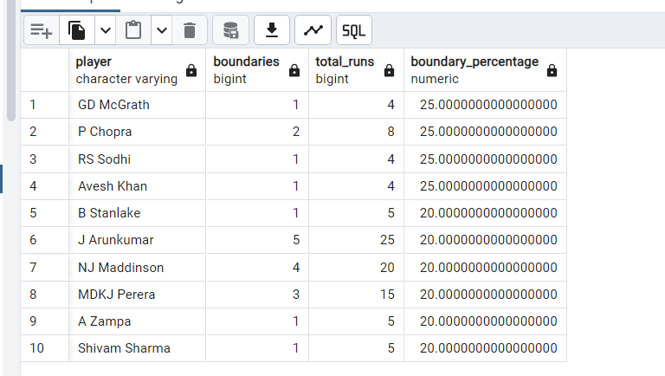
Hard-hitting Batters (Boundary Percentage):
SELECT batsman AS player,SUM(CASE WHEN total_run = 4 THEN 1 ELSE 0 END) + SUM(CASE WHEN total_run = 6 THEN 1 ELSE 0 END) AS boundaries,SUM(total_run) AS total_runs,CASE WHEN SUM(total_run) = 0 THEN 0 ELSE (SUM(CASE WHEN total_run= 4 THEN 1 ELSE 0 END) + SUM(CASE WHEN total_run= 6 THEN 1 ELSE 0 END)) * 100.0 / SUM(total_run) END AS boundary_percentage FROM table4 WHERE batsman IS NOT NULL GROUP BY batsman ORDER BY boundary_percentage DESC
LIMIT 10;

Slide 11
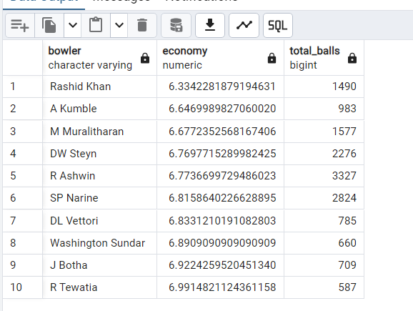
Bidding on Bowlers:
Economical Bowlers:
SELECT bowler,SUM(total_run) / (COUNT(ball) / 6.0) AS economy,COUNT(ball) AS total_balls FROM table4 WHERE bowler IS NOT NULL GROUP BY bowler HAVING COUNT(ball) >= 500 ORDER BY economy ASC
LIMIT 10;

Slide 12
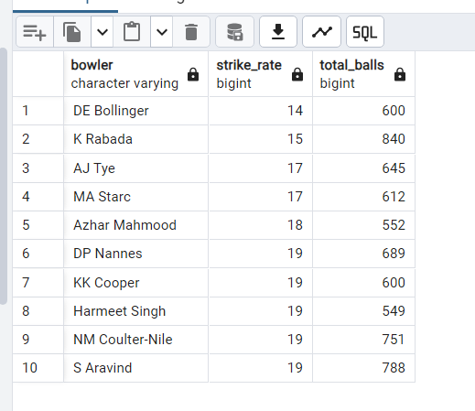
Wicket-taking Bowlers (Best Strike Rate):
SELECT bowler,COUNT(ball) / COUNT(DISTINCT player_dismissed) AS strike_rate,COUNT(ball) AS total_balls FROM table4 WHERE bowler IS NOT NULL GROUP BY bowler HAVING COUNT(ball) >= 500 ORDER BY strike_rate ASC LIMIT 10;

Slide 13
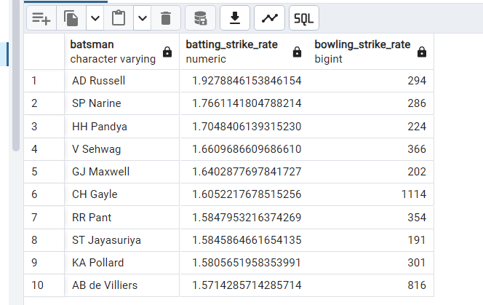
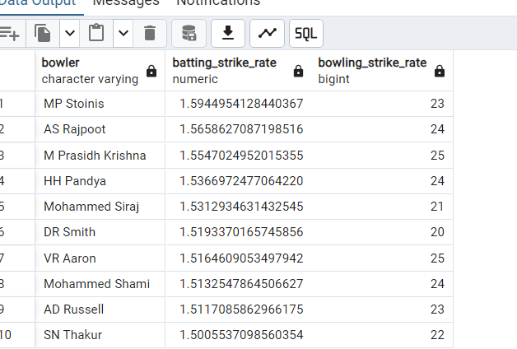
All-rounders
Best Batting and Bowling Strike Rate:
SELECT batsman, (SUM(total_run) * 1.0 / COALESCE(COUNT(CASE WHEN extras_type != 'wides' THEN table4.ball ELSE NULL END), 1)) AS batting_strike_rate, (COUNT(table4.ball) / COUNT(DISTINCT player_dismissed)) AS bowling_strike_rate FROM table4 WHERE batsman IS NOT NULL GROUP BY batsman HAVING COUNT(CASE WHEN extras_type != 'wides' THEN table4.ball ELSE NULL END) >= 500 AND COUNT(table4.ball) >= 300 ORDER BY batting_strike_rate DESC, bowling_strike_rate ASC LIMIT 10;
or
SELECT bowler, (SUM(total_run) * 1.0 / COALESCE(COUNT(CASE WHEN extras_type != 'wides' THEN table4.ball ELSE NULL END), 1)) AS batting_strike_rate, (COUNT(table4.ball) / COUNT(DISTINCT player_dismissed)) AS bowling_strike_rate FROM table4 WHERE batsman IS NOT NULL GROUP BY bowler HAVING COUNT(CASE WHEN extras_type != 'wides' THEN table4.ball ELSE NULL END) >= 500 AND COUNT(table4.ball) >= 300 ORDER BY batting_strike_rate DESC, bowling_strike_rate ASC LIMIT 10;

Slide 14
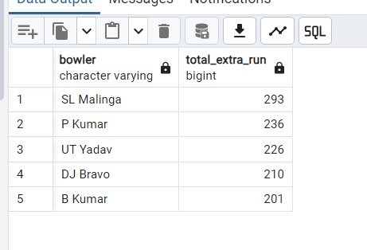
Top 5 bowlers who conceded maximum extra runs

Slide 15
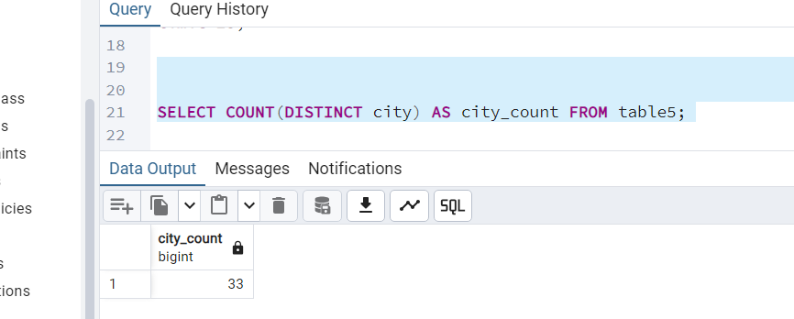
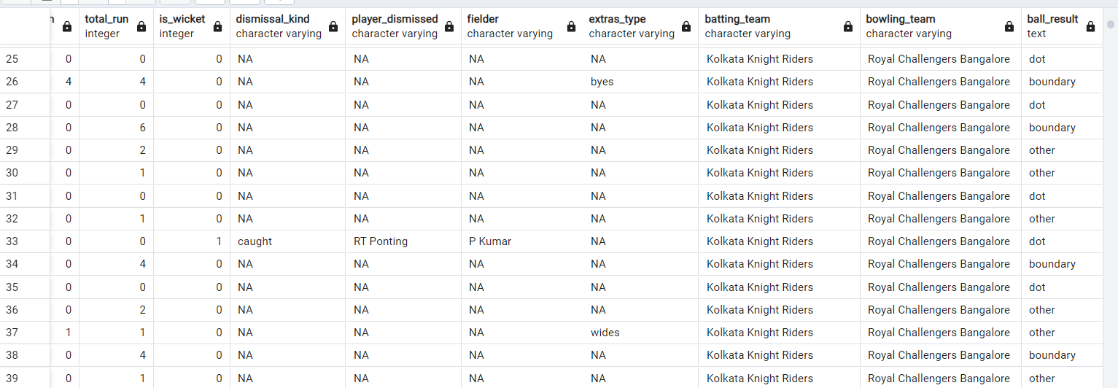
Additional Questions:
. Get the count of cities that have hosted an IPL match
SELECT COUNT(DISTINCT city) AS city_count FROM table5;
Create table deliveries_v02 with all the columns of the table ‘deliveries’ and an additional column ball_result containing values boundary, dot or other depending on the total_run (boundary for >= 4, dot for 0 and other for any other number)
CREATE TABLE deliveries_v02 ASSELECT *, CASE WHEN total_run >= 4 THEN 'boundary' WHEN total_run = 0 THEN 'dot' ELSE 'other' END AS ball_resultFROM table4;
In the same folder I attached a text file where all queries present , this pptx is for presentations

Slide 16
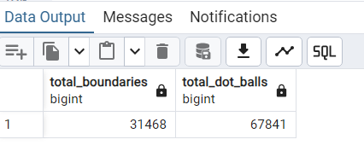
[table4 represent IPL_Ball Data
Write a query to fetch the total number of boundaries and dot balls from the deliveries_v02 table.
SELECT SUM(CASE WHEN ball_result = 'boundary' THEN 1 ELSE 0 END) AS total_boundaries, SUM(CASE WHEN ball_result = 'dot' THEN 1 ELSE 0 END) AS total_dot_balls FROM deliveries_v02;

Slide 17
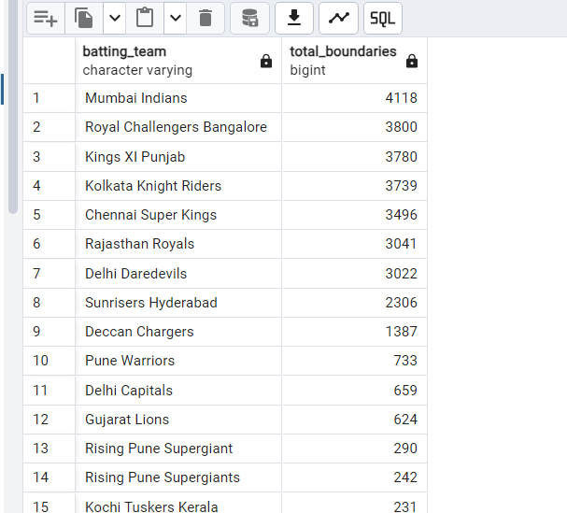
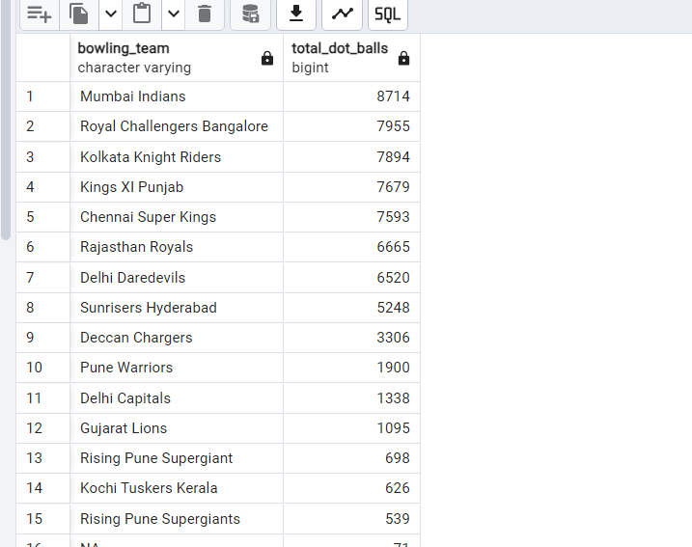
[table4 represent IPL_Ball Data
Write a query to fetch the total number of boundaries scored by each team from the deliveries_v02 table and order it in descending order of the number of boundaries scored.
SELECT batting_team, SUM(CASE WHEN ball_result = 'boundary' THEN 1 ELSE 0 END) AS total_boundaries FROM deliveries_v02 GROUP BY batting_team ORDER BY total_boundaries DESC;
Write a query to fetch the total number of dot balls bowled by each team and order it in descending order of the total number of dot balls bowled.
SELECT bowling_team, SUM(CASE WHEN ball_result = 'dot' THEN 1 ELSE 0 END) AS total_dot_balls FROM deliveries_v02 GROUP BY bowling_team ORDER BY total_dot_balls DESC;

Slide 18
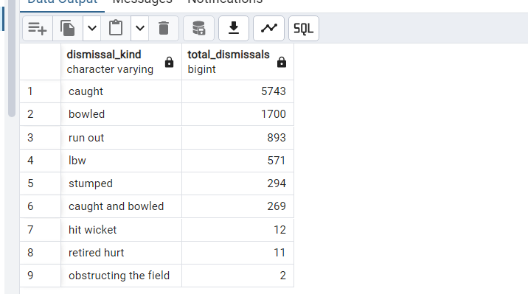
[table4 represent IPL_Ball Data
Write a query to fetch the total number of dismissals by dismissal kinds where dismissal kind is not NA
SELECT dismissal_kind, COUNT(*) AS total_dismissals FROM deliveries_v02 WHERE dismissal_kind != 'NA'GROUP BY dismissal_kind ORDER BY total_dismissals DESC;
Write a query to get the top 5 bowlers who conceded maximum extra runs from the deliveries table
SELECT bowler, SUM(extra_run) AS total_extra_run FROM table4 GROUP BY bowler ORDER BY total_extra_run DESC
LIMIT 5;
SELECT venue, SUM(total_run) AS total_runs_scoredFROM deliveries_v03GROUP BY venueORDER BY total_runs_scored DESC;

Slide 19
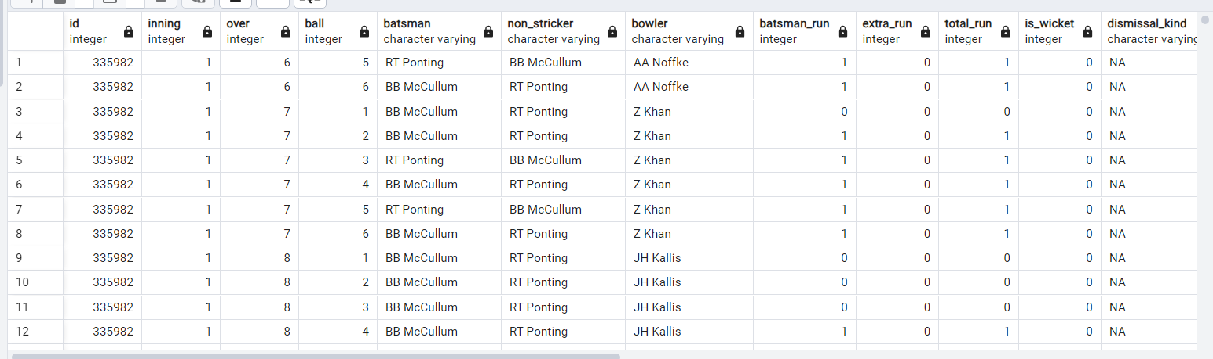
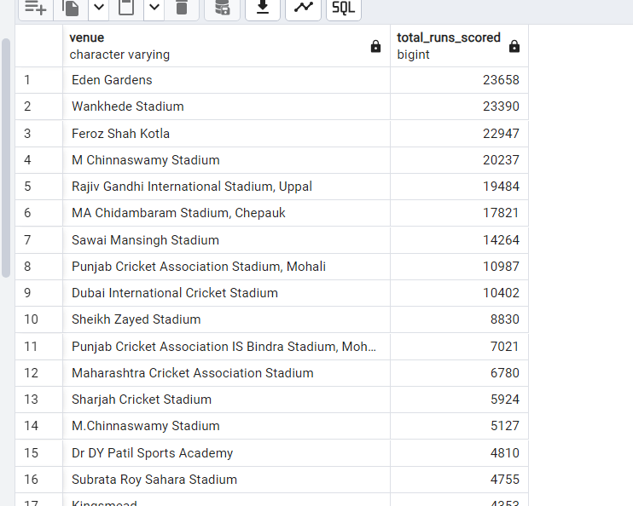
[table4 represent IPL_Ball Data
[table5 represent ipl_matches data]
Write a query to create a table named deliveries_v03 with all the columns of deliveries_v02 table and two additional column (named venue and match_date) of venue and date from table matches
CREATE TABLE deliveries_v03 AS SELECT
d.*, m.venue, m.date AS
match_date FROM table4 d
JOIN table5 m ON d.id = m.id;
Write a query to fetch the total runs scored for each venue and order it in the descending order of total runs scored.
SELECT venue, SUM(total_run) AS total_runs_scored FROM deliveries_v03 GROUP BY venue ORDER BY total_runs_scored DESC;

Slide 20
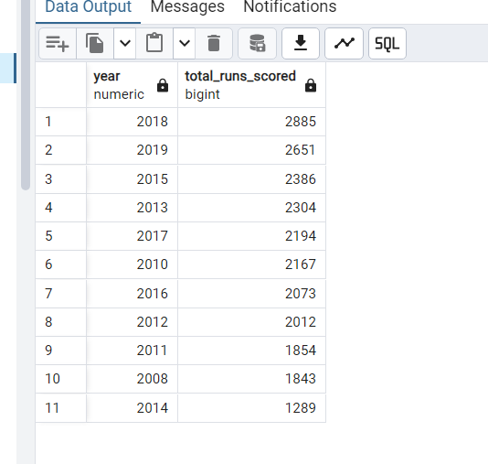
[table4 represent IPL_Ball Data
Write a query to fetch the year-wise total runs scored at Eden Gardens and order it in the descending order of total runs scored.
SELECT EXTRACT(YEAR FROM match_date) AS Year,SUM(total_run) AS total_runs_scored
FROM deliveries_v03 WHERE venue = 'Eden Gardens'GROUP BY EXTRACT(YEAR FROM match_date)
ORDER BY total_runs_scored DESC;

Slide 21
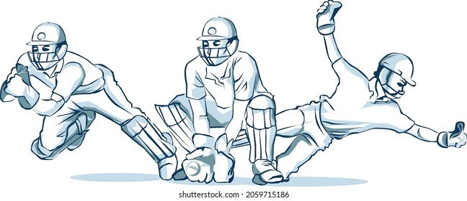
Wicketkeeper Criteria
I would define the following criteria to determine which wicketkeeper is the best, taking into account the needs of a T20 team: 1. Batting Strike Rate: To demonstrate their ability to score runs fast and forcefully, the wicketkeeper should have a high batting strike rate (SR) of at least 120.
2. Batting Average: A strong batting average of at least 25 demonstrates a player's reliability in scoring runs and interpersonal skills.
3. Dismissals: A high rate of dismissals (catches + stumpings) each game, with at least 20 dismissals in each of the previous two IPL seasons.
4. Catching Efficiency: The ability to hold onto catches and influence dismissals is demonstrated by a catching efficiency of at least 90%.

Slide 22

5. Running between wickets: The capacity to move swiftly between wickets and score runs; in the previous two IPL seasons, this ability has resulted in at least 50 runs.
By taking these factors into account, we can find a wicketkeeper who can help the team win in all facets of the game and who is also a strong gloveman and hitter.
List of suggested player name for wicketkeeper:
1.AD Russell
2.AC Glichrist
3.DE Bolinger
Etc.

